Slide 1
Marketing
MGT2016-Essentials of Marketing Management T P C 4 0 4
Dr.S.Arunkumar
Associate Professor
VSB

Slide 2
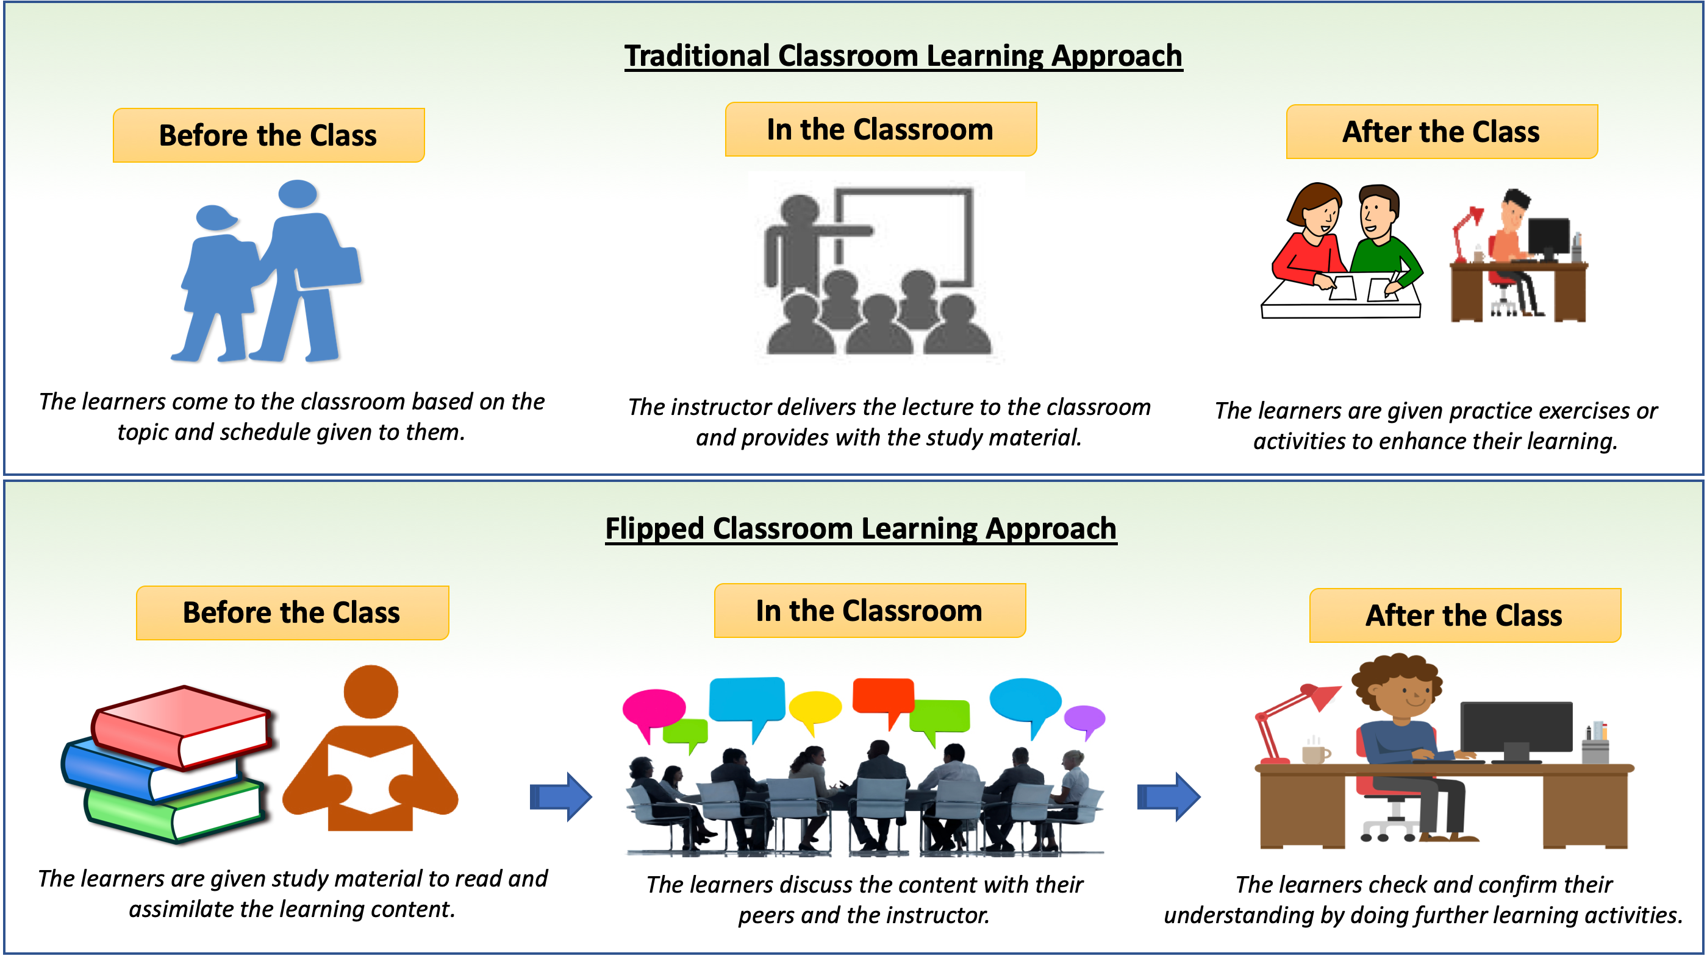

Slide 3
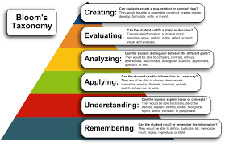

Slide 4
Why Engineers/Technologist need to learn Marketing
The product is the most obvious aspect of marketing for engineers. Designing and creating new products and services is the core job of an engineer. Although technology is important, marketing helps engineers to create better products. Marketing helps engineers to create products that meet the needs of customers.

Slide 5
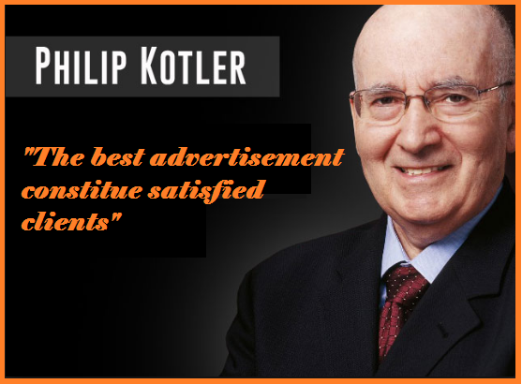

Slide 6
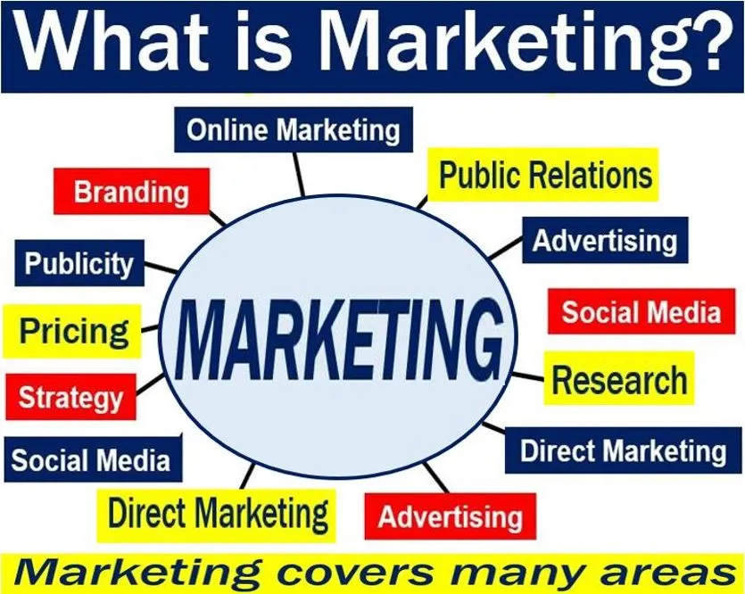

Slide 7
What is Marketing ?
Philip Kotler defines marketing as “the science and art of exploring, creating, and delivering value to satisfy the needs of a target market at a profit.
Marketing identifies unfulfilled needs and desires. It defines, measures and quantifies the size of the identified market and the profit potential.

Slide 8
Objectives
Develop the participants basic analytical skills. Conceptual abilities and substantive knowledge in the field of marketing management. It seeks to achieve the objectives by helping the participants undergo meaningful exercises in decision making in a variety of real life marketing situations.

Slide 9
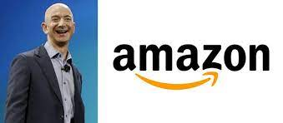


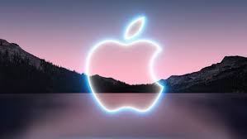

Slide 10
Course Outcome

Slide 11
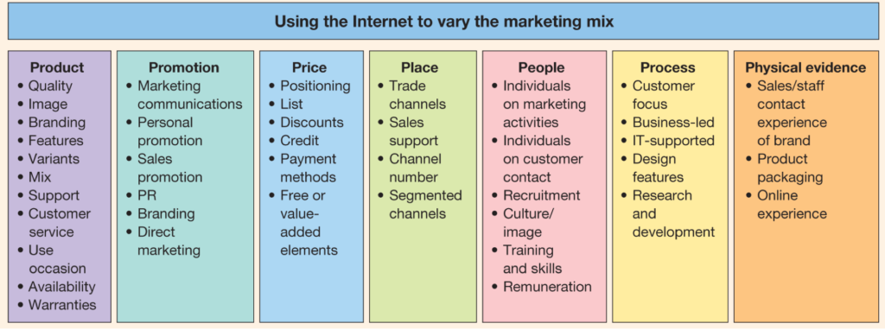
Module 1 Introduction to Marketing -5 Hours
Introduction to marketing and marketing process. Importance and scope of marketing.
Core concepts of marketing.
Company orientation towards market place.
Elements of the Marketing mix.

Slide 12
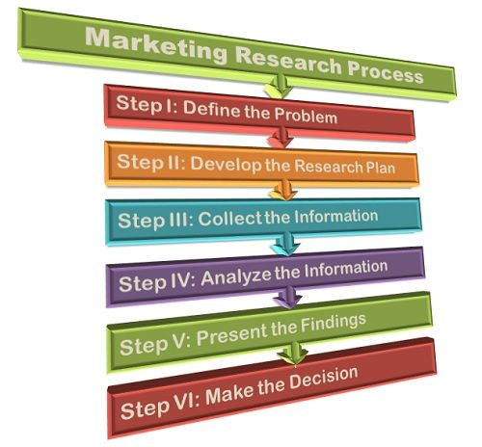
Module 2 Marketing Research -6 Hours
Discuss why marketers need marketing research.
Define marketing research and its importance.
Research plan.
Types of research.
Designing Surveys.

Slide 13

Module 3 Marketing Segmentation -5 Hours
Understand how to segment markets and why it is important.
Learn how to successfully select a target market for a product or service.
Create a buyer persona from a customer segment.

Slide 14
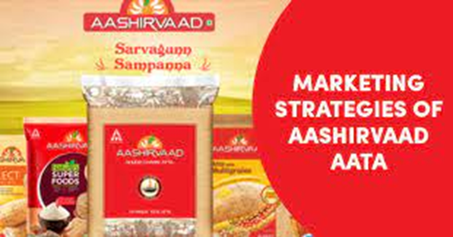
Module 4 Marketing Positioning -5 Hours
Define what positioning is and why it is important to marketers.
Describe how positioning helps brands and products have greater success.
Positioning strategies.
Common positioning problems.

Slide 15
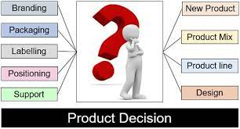
Module 5 Product Decisions -5 Hours
Types of consumer Products.
Product line and mixes.
Product levels.
Product life cycle.
New product and service development process.

Slide 16
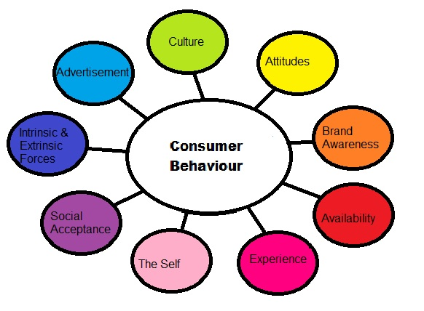
Module 6 Buyer Behaviour -7 Hours
Types of products and buying situations. Consumer buying process-B2C, B2B and services.
Marketing intervention during every stage of buying process.

Slide 17
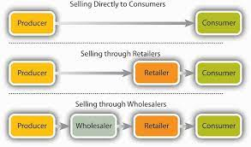
Module 7 Channel Management and Distribution Decisions -5 Hours
Place- Distribution channel Management.
Channel functions and strategy.
Channel structure.
Channel behaviour and organisation.
Channel management decisions.
Process of supply chain management. Distribution channel and strategy.

Slide 18
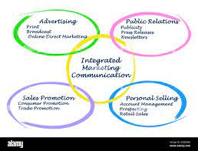
Module 8 Integrated Marketing Communication Decisions-5 Hours
Communication mix.
Developing effective marketing communication. Advertising and public relations.
Managing mass communications-Advertising, Sales Promotions, Events and Experiences, and Public Relations.

Slide 19
Module 9 Marketing Environment -6 Hours
Influence of the immediate environment on an organization.
Influence of the external environment on an organization.
Understand environmental scanning for an industry or company.
PESTLE analysis; Porter's Five Forces; BCG Matrix.

Slide 20
What is Marketing ?
Philip Kotler defines marketing as “the science and art of exploring, creating, and delivering value to satisfy the needs of a target market at a profit.
Marketing identifies unfulfilled needs and desires. It defines, measures and quantifies the size of the identified market and the profit potential.

Slide 21

Defining Marketing for the New Realities

Slide 22

Learning Objectives
Why is marketing important?
What is the scope of marketing?
What are some core marketing concepts?
What forces are defining the new marketing realities?
What new capabilities have these forces given consumers and companies?
What does a holistic marketing philosophy include?
What tasks are necessary for successful marketing management?

Slide 23
The Value of Marketing
Financial success often depends on marketing ability Successful marketing builds demand for products and services, which, in turn, creates jobs.
Marketing builds strong brands and a loyal customer base, intangible assets that contribute heavily to the value of a firm.
Notes:
There is little margin for error in marketing. Just a short time ago, MySpace, Yahoo!, Blockbuster, and Barnes & Noble were admired leaders in their industries. What a difference a few years can make! Each of these brands has been completely overtaken by an upstart challenger—Facebook, Google, Netflix, and Amazon—and they now struggle, sometimes unsuccessfully, for mere survival.

Slide 24
Finance, operations, accounting, and other business functions won’t really matter without sufficient demand for products and services so the firm can make a profit. Thus, financial success often depends on marketing ability. Marketing’s value extends to society as a whole. It has helped introduce new or enhanced products that ease or enrich people’s lives. Successful marketing builds demand for products and services, which, in turn, creates jobs. By contributing to the bottom line, successful marketing also allows firms to more fully engage in socially responsible activities

Slide 25
The Scope of Marketing
Marketing is about identifying and meeting human and social needs.
AMA’s formal definition: Marketing is the activity, set of institutions, and processes for creating, communicating, delivering, and exchanging offerings that have value for customers, clients, partners, and society at large.
Notes:
One of the shortest good definitions of marketing is “meeting needs profitably.”

Slide 26
Marketing Management
The art and science of choosing target markets and getting, keeping, and growing customers through creating, delivering, and communicating superior customer value.
Notes:
Marketing management takes place when at least one party to a potential exchange thinks about the means of achieving desired responses from other parties.

Slide 27
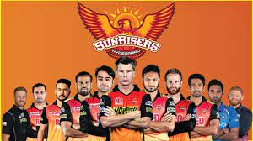
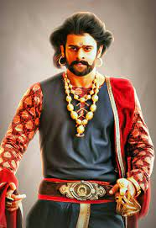
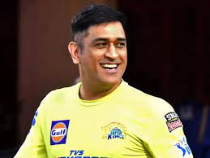
What is Marketed?
Goods
Services
Events
Experiences
Persons
Notes:
Marketers market 10 main types of entities: goods, services, events, experiences, persons, places, properties, organizations, information, and ideas.

Slide 28


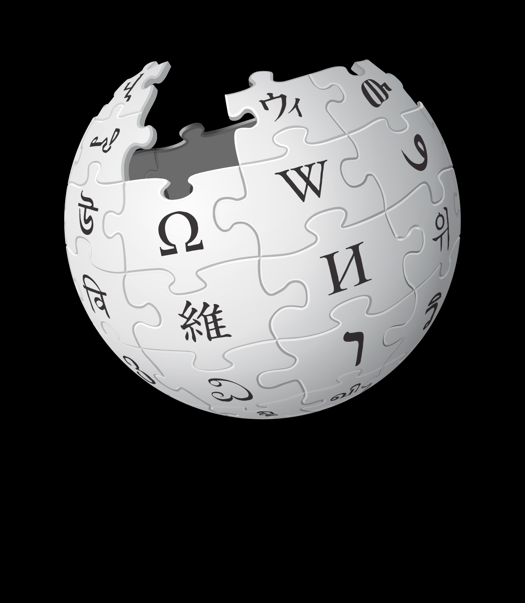
What is Marketed?
Places
Properties
Organizations
Information
Ideas
Notes:
Marketers market 10 main types of entities: goods, services, events, experiences, persons, places, properties, orga- nizations, information, and ideas.

Slide 29
Who Markets?
A marketer is someone who seeks a response—attention, a purchase, a vote, a donation—from another party, called the prospect.
Notes:
If two parties are seeking to sell something to each other, we call them both marketers.

Slide 30

8 Demand States
Negative(Dental work)
Nonexistent(Family Planning)
Latent(Latent demand is basically a type of demand that the consumer realizes it later onwards)
Declining
Irregular
Unwholesome(he customer should not desire the product, yet the customer wants the product badly. Best example of unwholesome demand are cigarettes, alcohol, pirated movies)
Full(The products have the same demand all over the year. For example, medicines always have full demand).
Overfull(Price of Product goes up during festival seasons).
Notes:
Negative demand—Consumers dislike the product and may even pay to avoid it.
Nonexistent demand—Consumers may be unaware of or uninterested in the product.
Latent demand—Consumers may share a strong need that cannot be satisfied by an existing product.
Declining demand—Consumers begin to buy the product less frequently or not at all.
Irregular demand—Consumer purchases vary on a seasonal, monthly, weekly, daily, or even hourly basis.
Full demand—Consumers are adequately buying all products put into the marketplace.
Overfull demand—More consumers would like to buy the product than can be satisfied.
Unwholesome demand—Consumers may be attracted to products that have undesirable social consequences.

Slide 31
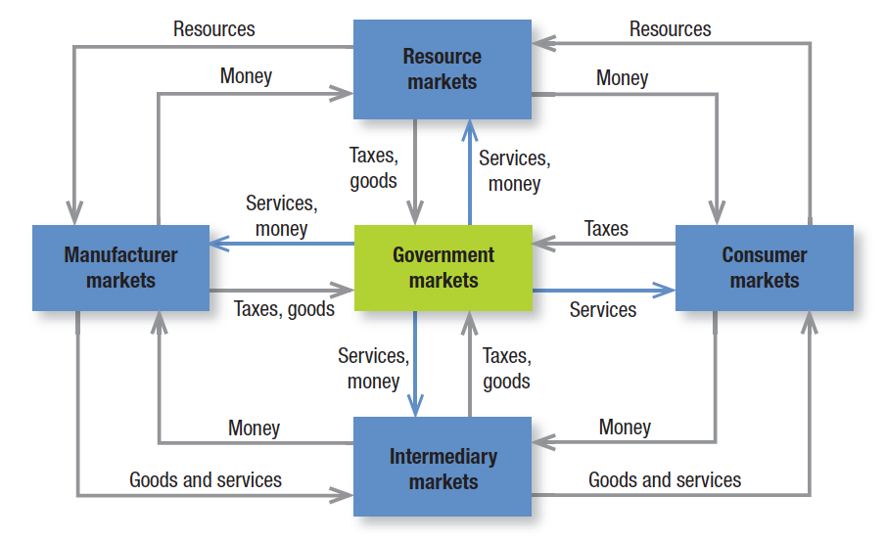
Fig. 1.1 Structure Of Flows In A Modern Exchange Economy
Notes:
Five basic markets and their connecting flows are shown in Figure 1.1. Manufacturers go to resource markets (raw material markets, labor markets, money markets), buy resources and turn them into goods and services, and sell finished products to intermediaries, who sell them to consumers. Consumers sell their labor and receive money with which they pay for goods and services. The government collects tax revenues to buy goods from resource, manufacturer, and intermediary markets and uses these goods and services to provide public services. Each nation’s economy, and the global economy, consists of interacting sets of markets linked through exchange processes.

Slide 32
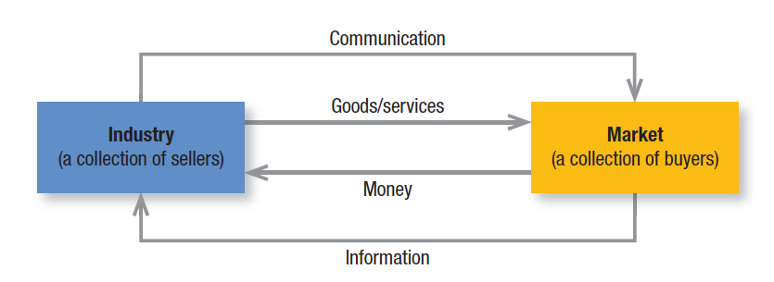
Fig. 1.2 A Simple Marketing System
Notes:
Figure 1.2 shows how sellers and buyers are connected by four flows. Sellers send goods and services and com- munications such as ads and direct mail to the market; in return they receive money and information such as cus- tomer attitudes and sales data. The inner loop shows an exchange of money for goods and services; the outer loop shows an exchange of information.

Slide 33

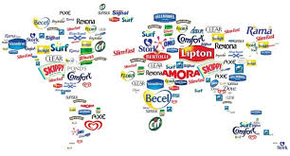
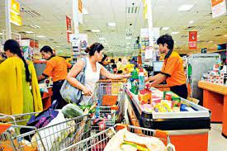

Key Customer Markets
Consumer markets
Business markets
Global markets
Nonprofit & governmental markets
Notes:
Consumer Markets Companies selling mass consumer goods and services such as juices, cosmetics, athletic shoes, and air travel establish a strong brand image by developing a superior product or service, ensuring its availability, and backing it with engaging communications and reliable performance.
Business Markets Companies selling business goods and services often face well-informed professional buyers skilled at evaluating competitive offerings. Advertising and Web sites can play a role, but the sales force, the price, and the seller’s reputation may play a greater one.
Global Markets Companies in the global marketplace navigate cultural, language, legal, and political differences while deciding which countries to enter, how to enter each (as exporter, licenser, joint venture partner, contract manufacturer, or solo manufacturer), how to adapt product and service features to each country, how to set prices, and how to communicate in different cultures.
Nonprofit and Governmental Markets Companies selling to nonprofit organizations with limited purchasing power such as churches, universities, charitable organizations, and government agencies need to price carefully. Much government purchasing requires bids; buyers often focus on practical solutions and favor the lowest bid, other things equal.

Slide 34

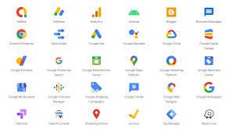
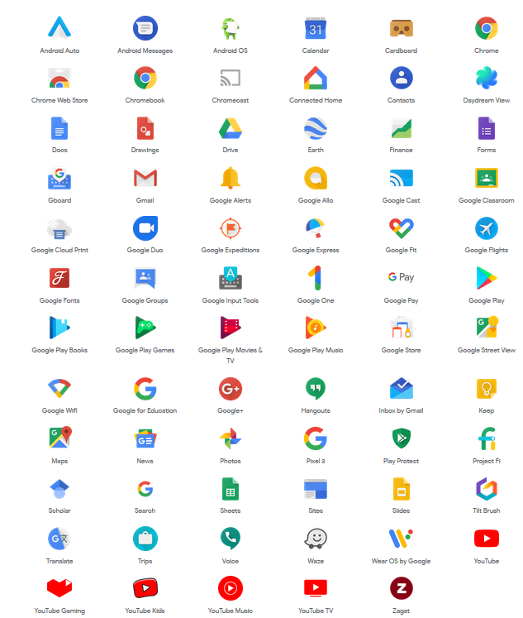
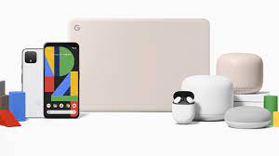


Slide 35
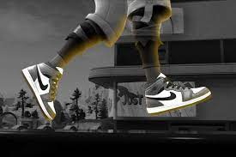
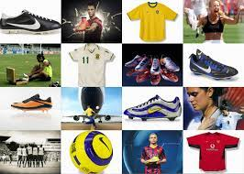
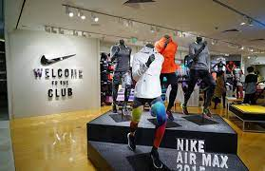
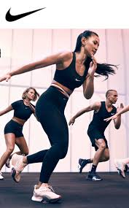

Slide 36
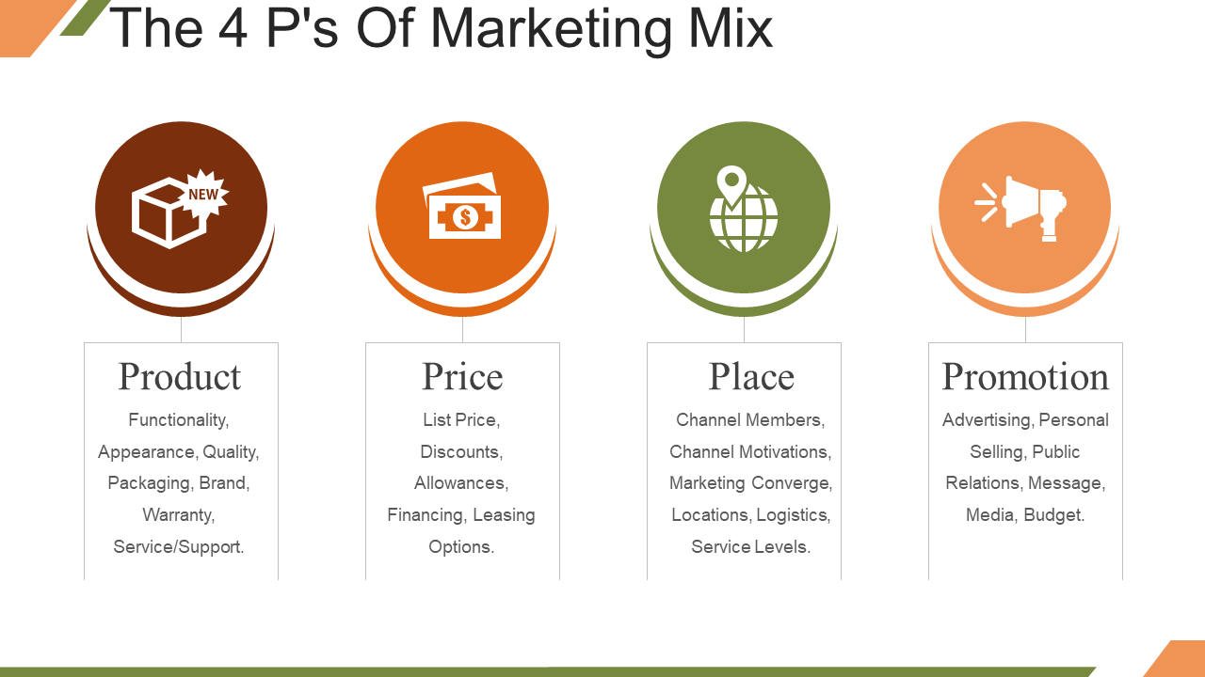

Slide 37
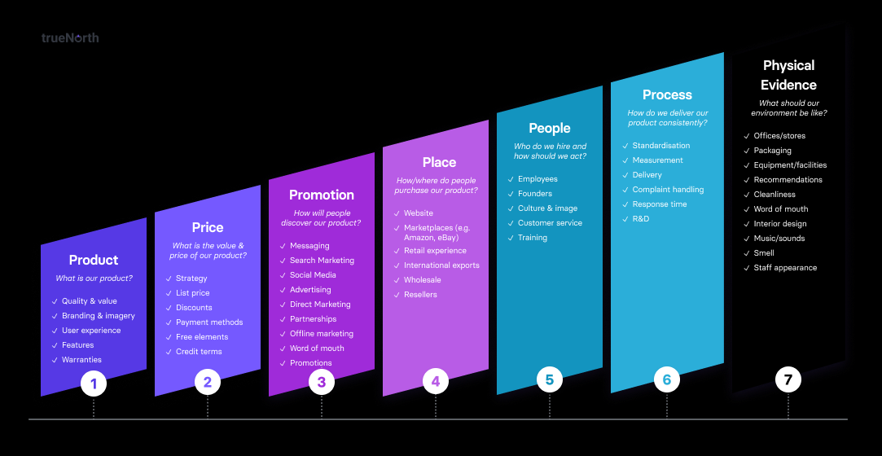

Slide 38


Slide 39
Core Marketing Concepts Needs, Wants, and Demands Needs are the basic human requirements such as for air, food, water, clothing, and shelter. Humans also have strong needs for recreation, education, and entertainment. These needs become wants when directed to specific objects that might satisfy the need. Our wants are shaped by our society. Demands are wants for specific products backed by an ability to pay. Many people want a Mercedes; only a few can buy one. Companies must measure not only how many people want their product, but also how many are willing and able to buy it.

Slide 40
We can distinguish five types of needs: 1. Stated needs (The customer wants an inexpensive car.) 2. Real needs (The customer wants a car whose operating cost, not initial price, is low.) 3. Unstated needs (The customer expects good service from the dealer.) 4. Delight needs (The customer would like the dealer to include an onboard GPS system.) 5. Secret needs (The customer wants friends to see him or her as a savvy consumer.) Apple worked hard to shape consumer perceptions of them. To gain an edge, companies must help customers learn what they want.

Slide 41
Target Markets, Positioning, and Segmentation Not everyone likes the same cereal, restaurant, university, or movie. Marketers therefore identify distinct segments of buyers by identifying demographic, psychographic, and behavioral differences between them. They then decide which segment(s) present the greatest opportunities. For each of these target markets, the firm develops a market offering that it positions in target buyers’ minds as delivering some key benefit(s). Volvo develops its cars for the buyer to whom safety is a major concern, positioning them as the safest a customer can buy. Porsche targets buyers who seek pleasure and excitement in driving and want to make a statement about their wheels.

Slide 42
Offerings and Brands Companies address customer needs by putting forth a value proposition, a set of benefits that satisfy those needs. The intangible value proposition is made physical by an offering, which can be a combination of products, services, information, and experiences. A brand is an offering from a known source. A brand name such as Apple carries many different kinds of associations in people’s minds that make up its image: creative, innovative, easy-to-use, fun, cool, iPod, iPhone, and iPad to name just a few. All companies strive to build a brand image with as many strong, favorable, and unique brand associations as possible.

Slide 43
Marketing Channels To reach a target market, the marketer uses three kinds of marketing channels. Communication channels deliver and receive messages from target buyers and include newspapers, magazines, radio, television, mail, telephone smart phone, billboards, posters, fliers, CDs, audiotapes, and the Internet. Beyond these, firms communicate through the look of their retail stores and Web sites and other media, adding dialogue channels such as e-mail, blogs, text messages, and URLs to familiar monologue channels such as ads. Distribution channels help display, sell, or deliver the physical product or service(s) to the buyer or user. These channels may be direct via the Internet, mail, or mobile phone or telephone or indirect with distributors, wholesalers, retailers, and agents as intermediaries. To carry out transactions with potential buyers, the marketer also uses service channels that include warehouses, transportation companies, banks, and insurance companies. Marketers clearly face a design challenge in choosing the best mix of communication, distribution, and service channels for their offerings.

Slide 44
Paid, Owned, and Earned Media
Paid media include TV, magazine and display ads, paid search, and sponsorships, all of which allow marketers to show their ad or brand for a fee.
Owned media are communication channels marketers actually own, like a company or brand brochure, Web site, blog,
Facebook page, or Twitter account.
Earned media are streams in which consumers, the press, or other outsiders voluntarily communicate something about the brand via word of mouth, buzz, or viral marketing methods.
The emergence of earned media has allowed some companies, such as Chipotle, to reduce paid media expenditures

Slide 45
Impressions-which occur when consumers view a communication, are a useful metric for tracking the scope or breadth of a communication’s reach that can also be compared across all communication types.
Engagement -is the extent of a customer’s attention and active involvement with a communication-Facebook “likes,” Twitter tweets, comments on a blog or Web site, and sharing of video or other content.

Slide 46
Value and Satisfaction-The buyer chooses the offerings he or she perceives to deliver the most value, the sum of the tangible and intangible benefits and costs.
Value, a central marketing concept, is primarily a combination of quality, service, and price (qsp), called the customer value triad.
Value perceptions increase with quality and service but decrease with price.
Satisfaction reflects a person’s judgment of a product’s perceived performance in relationship to expectations.
If performance falls short of expectations, the customer is disappointed. If it matches expectations, the customer is satisfied.
If it exceeds them, the customer is delighted.

Slide 47
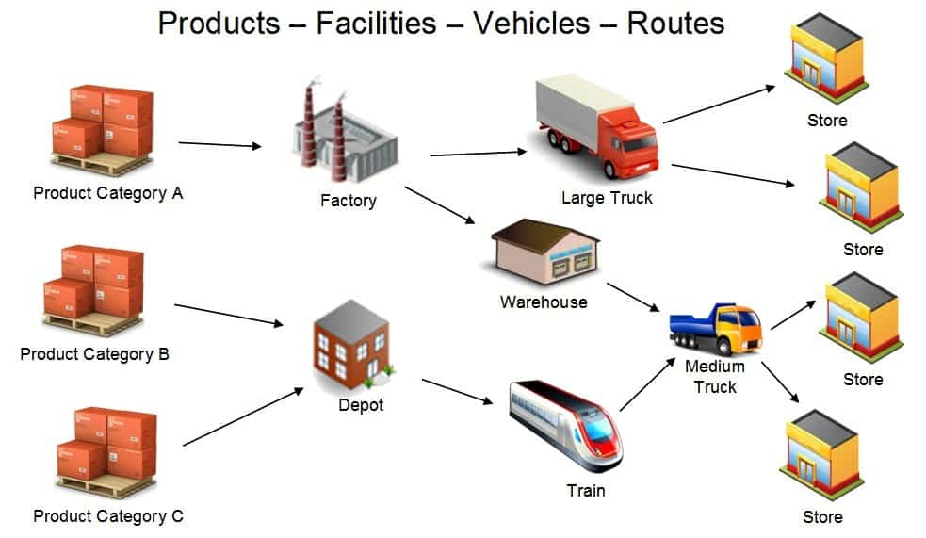

Slide 48
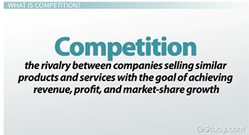

Slide 49
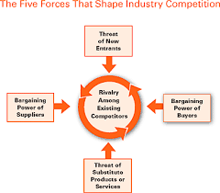

Slide 50
Marketing Environment
The marketing environment consists of the task environment and the broad environment.
The task environment includes the actors engaged in producing, distributing, and promoting the offering These are the company, suppliers, distributors, dealers, and target customers.
In the supplier group are material suppliers and service suppliers, such as marketing research agencies, advertising agencies, banking and insurance companies, transportation companies, and telecommunications companies.
Distributors and dealers include agents, brokers, manufacturer representatives, and others who facilitate finding and selling to customers.

Slide 51
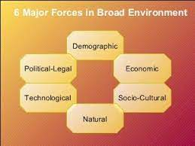
The broad environment consists of six components: demographic environment, economic environment,
social- cultural environment, natural environment, technological environment, and political-legal environment.

Slide 52
Company Orientation toward the Marketplace
The Production Concept
The production concept is one of the oldest concepts in business.
It holds that consumers prefer products that are widely available and inexpensive.
Managers of production-oriented businesses concentrate on achieving high production efficiency, low costs, and mass distribution.
This orientation has made sense in developing countries such as China, where the largest PC manufacturer, Legend (principal owner of Lenovo Group), and domestic appliances giant Haier have taken advantage of the country’s huge and inexpensive labor pool to dominate the market.
Marketers also use the production concept when they want to expand the market.

Slide 53
The Product Concept
The product concept proposes that consumers favor products offering the most quality, performance, or innovative
features.
However, managers are sometimes caught in a love affair with their products. They might commit the “bettermousetrap”fallacy, believing a better product will by itself lead people to beat a path to their door.
As many start-ups have learned the hard way, a new or improved product will not necessarily be successful unless it’s priced, distributed, advertised, and sold properly.

Slide 54
The Selling Concept
The selling concept holds that consumers and businesses, if left alone, won’t buy enough of the organization’s products.
It is practiced most aggressively with unsought goods—goods buyers don’t normally think of buying such as insurance and cemetery plots—and when firms with overcapacity aim to sell what they make, rather than make what the market wants.
Marketing based on hard selling is risky. It assumes customers coaxed into
buying a product not only won’t return or bad-mouth it or complain to consumer organizations but might even buy it again.

Slide 55
The Marketing Concept
The marketing concept emerged in the mid-1950s as a customer-centered, sense-and-respond philosophy.
The job is to find not the right customers for your products, but the right products for your customers.
Dell doesn’t prepare a PC or laptop for its target market. Rather, it provides product platforms on which each person customizes the features he or she desires in the machine.
The marketing concept holds that the key to achieving organizational goals is being more effective than competitors in creating, delivering, and communicating superior customer value to your target markets.

Slide 56
Harvard’s Theodore Levitt drew a perceptive contrast between the selling and marketing concepts: Selling focuses on the needs of the seller; Marketing on the needs of the buyer. Selling is preoccupied with the seller’s need to convert his product into cash; Marketing with the idea of satisfying the needs of the customer by means of the product and the whole cluster of things associated with creating, delivering, and finally consuming it.

Slide 57
The Holistic Marketing Concept
Without question, the and forces that have defined the new marketing realities in the first years of trends the 21st century are leading business firms to embrace a new set of beliefs and practices.
The holistic marketing concept is based on the development, design, and implementation of marketing programs, processes, and activities that
recognize their breadth and interdependencies.
Holistic marketing acknowledges that everything matters in marketing—
and that a broad, integrated perspective is often necessary.
Holistic marketing thus recognizes and reconciles the scope and complexities of marketing activities.
Figure below provides a schematic overview of four broad components characterizing holistic marketing: relationship marketing,
integrated marketing, internal marketing, and socially responsible marketing.

Slide 58
